Slide 1


BLG 477E
MULTIMEDIA COMPUTING
TERM PROJECT PRESENTATION
HEAD POSE ESTIMATION
UMUT YAZGAN
150130031
HARUN ÇATAL
150130034
15.05.2018

Slide 2

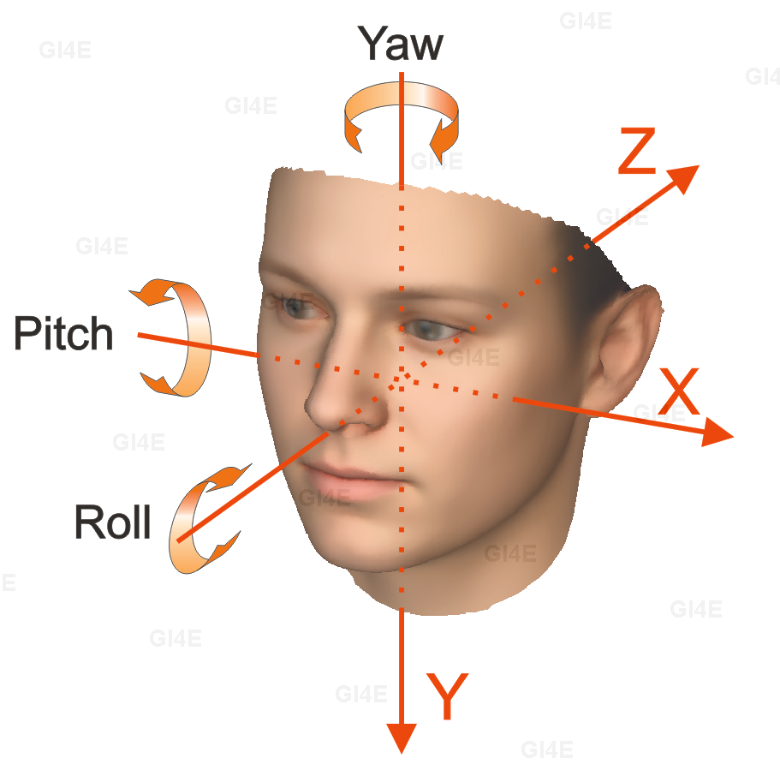
- INTRODUCTION
What is head pose estimation ?

Slide 3
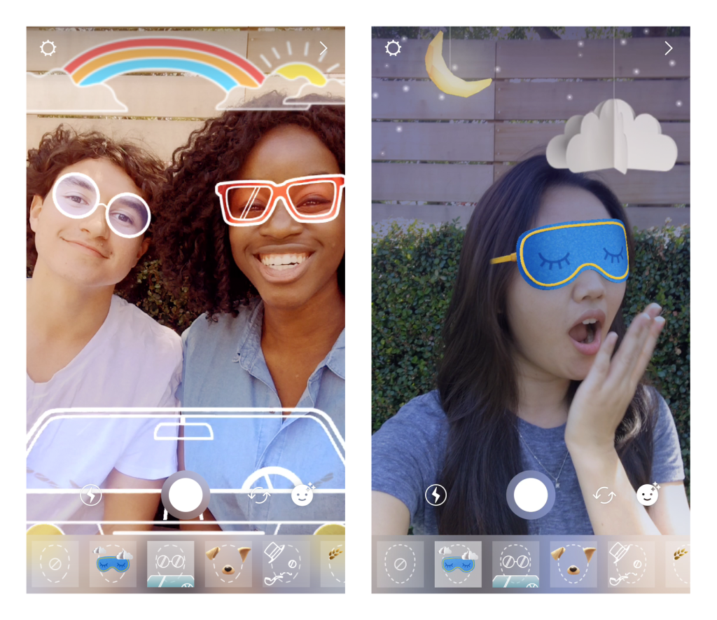
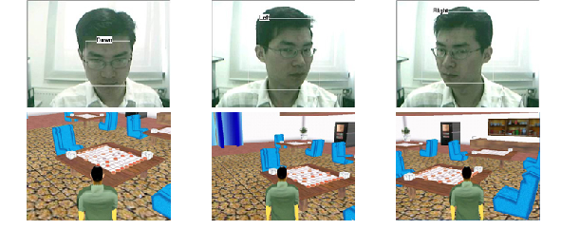
- INTRODUCTION
Using areas of head pose estimation

Slide 4
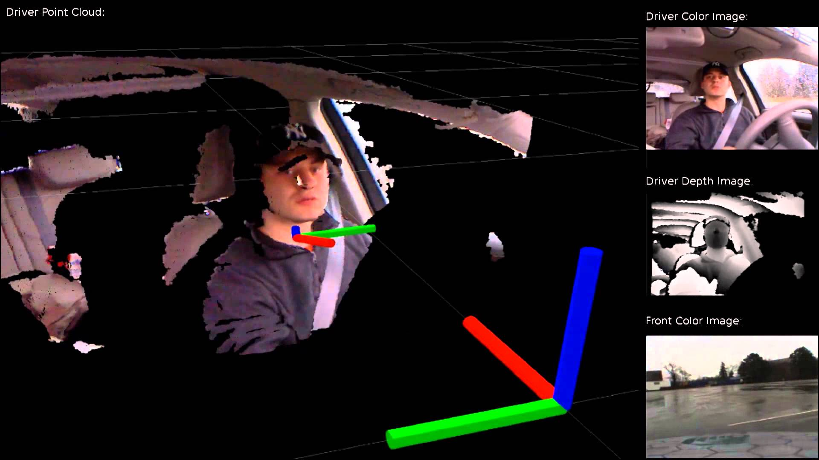
- INTRODUCTION
Using areas of head pose estimation

Slide 5
- HEAD POSE ESTIMATION
How to matematically represent camera motion ?
Translation : Moving camera from current location to another location. Represented by a vector ( X' - X, Y' - Y , Z' - Z )
Rotation : Camera angle ( X, Y, Z ) Represented with Euler angles, a 3x3 rotation matrix or a direction of rotation and angle
Finally 6 coordinates (3 coordinates from translation, 3 coordinates from rotation) are required for estimating the pose of 3D object means.

Slide 6
- HEAD POSE ESTIMATION
What do we need for head pose estimation ?
2D coordinates of a few points - Some important point in human face - 2D (x,y) coordinates of required - Corners of the eyes, the tip of nose, corners of the mouth, chin

Slide 7
- HEAD POSE ESTIMATION
What do we need for head pose estimation ?
World Coordinates - 3D locations of the some points
Tip of the nose : ( 0, 0, 0)
Chin : ( 0, -330, -65)
Left corner of the left eye : (-225, 170, -135)
Right corner of the right eye : ( 225, 170, -135)
Left corner of the mouth : (-150, -150, -125)
Right corner of the mouth : (150, -150, -125)

Slide 8
- HEAD POSE ESTIMATION
What do we need for head pose estimation ?
Intrinsic parameters of the camera Camera should be calibrated. However, an approximation would be enough.

Slide 9
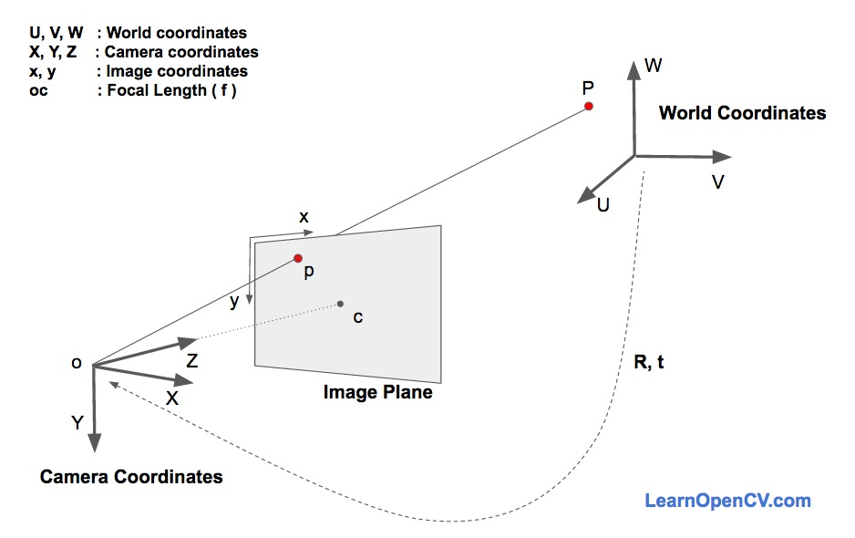
- HEAD POSE ESTIMATION
How do head pose estimation algorithms work ?

Slide 10
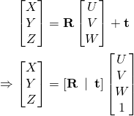

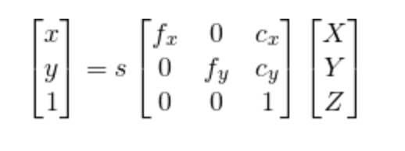
- HEAD POSE ESTIMATION
How do head pose estimation algorithms work ?
Direct Linear Transform
Levenberg – Marquard Optimization

Slide 11


- INTRODUCTION
Which technologies we used ?
İmutils
numpy
Facial Landmark Predictor
Frontal Face Detector
SolvePnP

Slide 12
Demonstration

Slide 13
Thanks for your listening
UMUT YAZGAN
HARUN ÇATAL

